Slide 1

Green Pace
Security Policy Presentation
Developer: Justin Parker

Slide 2

OVERVIEW: DEFENSE IN DEPTH
The security policy will ensure safety in Green Pace and help prevent cyber stacks.

Slide 3
THREATS MATRIX
The coding standard will fall under certain category. These categories are high or low priority.
Likely: Common Threats | Priority: Threats that are immediate
Low priority: Low level threats that can be looked at last | Unlikely: Lower common threats

Slide 4
10 PRINCIPLES
Input Validation
Compiler Warnings
Simple Design
Default Deny
Defense in Depth (DiD)
Principle of lease privilege
Designed for secure policies
Sanitize data
Quality assurance
Secure coding standard

Slide 5
CODING STANDARDS
Avoid out-of-range enumeration value
Avoid creating std::string with null pointer
Using valid iterator range
Avoid freed access memory
Avoid storing already known pointer value in unrelated pointer
Static assertion used for testing
Use all exceptions
Use one-definition rule
Valid references, pointers, and iterators
Position call should be used when calling input and output

Slide 6
ENCRYPTION POLICIES
Encryption at flight – Data is encrypted while going from point A to point B. Attackers could be looking to intercept the data.
Encryption in rest – Attacks cannot happen when data is in a rest state. This style will help protect data that isn’t even being used.
Encryption in use – Data that is being created, read, updated, etc. This style would fall between rest and flight .

Slide 7
TRIPLE-A POLICIES
Authentication – Validating a user before they can gain access to the information. Username and password is the most common way of authentication.
Authorization – The ability to access certain data when a user has the ability to. Not everyone will have the ability to access the same data, so it is important to authorize what data can be accessed by a user.
Accounting – The system will log who is accessing the system. This analysis can provide many different types of data to the admin.

Slide 8
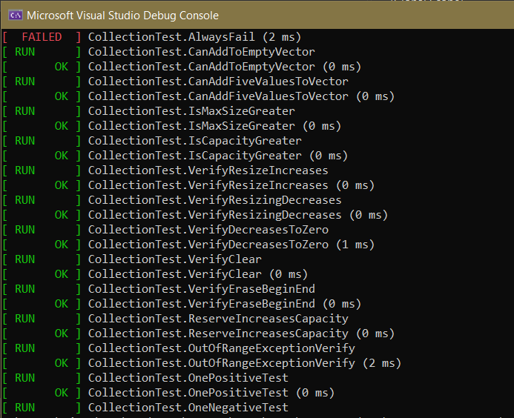
Unit Testing
Unit tests can help detect issues with the code early. Input overflow is one of the tests that can be used.

Slide 9

AUTOMATION SUMMARY

Slide 10
TOOLS
DevSecOps is a security practice policy design that helps the software development lifecycle securely.
CPP Check should be used throughout the design process. The idea is to check the code for issues as often as you would like. Once changes are made, the designer will have the ability to test and retest.

Slide 11
RISKS AND BENEFITS
There are always risks and benefits to any software process. Creating secure code will limit the ability of attackers to access data that they shouldn’t access. There will always be a way for attackers to get into data, but its our responsibility to adapt and protect. Using Defense in Depth will help us protect in layers, so that it is harder for a hacker to get into the system.

Slide 12
RECOMMENDATIONS
Security must be first priority
Run multiple Tests
Always adapt to change
Penetration testing
Policies must be followed

Slide 13
CONCLUSIONS
Policies must be followed to help secure systems and programs. Without following these policies, it can lead to security problems. Safer and more efficient code will help the program run better and more securely.

Slide 14
REFERENCES
SEI CERT C++ Coding Standard - Confluence. (2020, May 29). SEI CERT C++ Coding Standard. https://wiki.sei.cmu.edu/confluence/pages/viewpage.action?pageId=88046682
DevSecOps Pipeline Overview. (n.d.). Devsecops pipeline overview: Devsecops simplified | perforce software. Perforce Software. https://www.perforce.com/blog/kw/devsecops-pipeline-overview

